Slide 1

JOCO: The Future of Travel with Smart Luggage

Slide 2
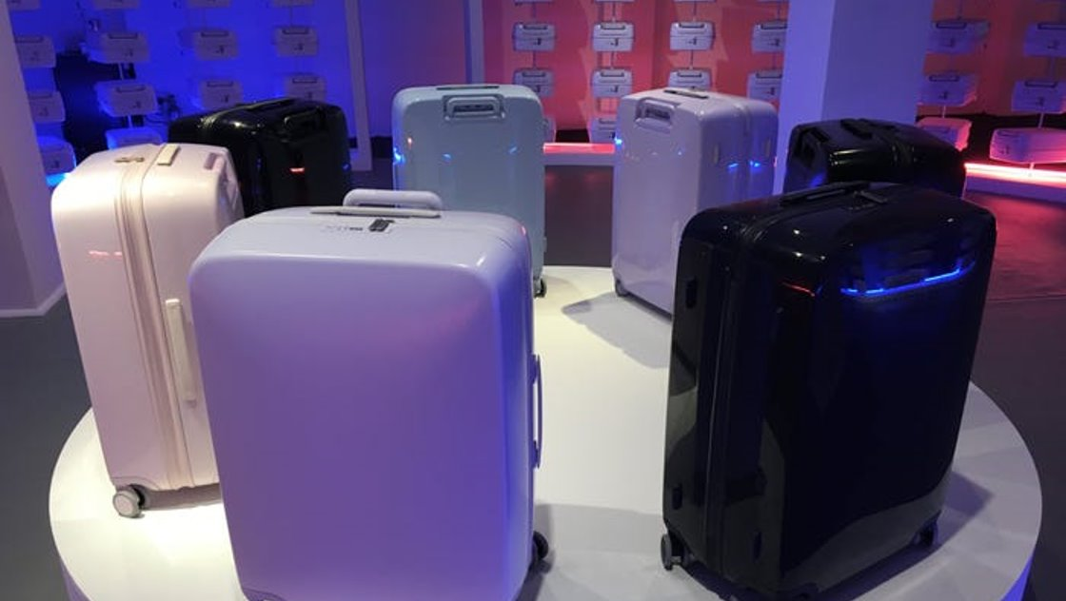
Revolutionizing Travel Experience
Illustration of JOCO Smart Luggage
Introduction to JOCO and its innovative features
Brief overview of what the presentation will cover

Slide 3

The Hassles of Journey Companion
Heavy lifting and carrying: Traditional luggage often led to physical strain and fatigue, especially when navigating through crowded airports or train stations
Difficulty in crowded areas: Manoeuvring bulky luggage through busy terminals or narrow streets can be challenging and time-consuming
Risk of theft or loss: Limited security measures in conventional luggage make travellers vulnerable to theft or misplacement of belongings

Slide 4



Meet JOCO: Your Travel Companion
Built-in sensors for automatic following: JOCO's sensors detect the user's movements and autonomously follow at a safe distance, eliminating the need to drag or carry luggage
Smart navigation technology: JOCO utilizes GPS and mapping technology to navigate various environments, ensuring seamless travel from airports to city streets
Secure locking mechanism: JOCO's robust locking mechanism provides peace of mind by safeguarding belongings during transit

Slide 5


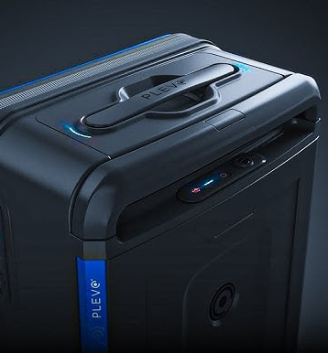
The Technology Behind JOCO
Proximity sensors: JOCO employs proximity sensors to detect the user's position and adjust its speed and direction, accordingly, ensuring smooth tracking
GPS integration: Integrated GPS enables JOCO to map its surroundings and autonomously navigate through complex environments
AI algorithms: AI algorithms optimize JOCO's performance, enabling features like obstacle avoidance and efficient route planning

Slide 6
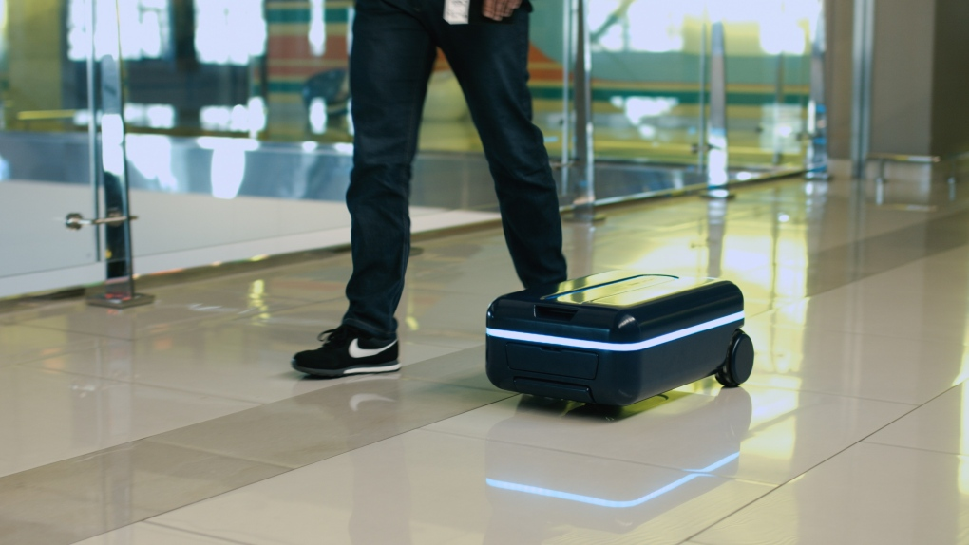

Why Choose JOCO?
Hands-free travel experience: JOCO allows travellers to move comfortably without the burden of carrying luggage, enhancing mobility and convenience
Enhanced security features: With its secure locking mechanism and tracking capabilities, JOCO reduces the risk of theft or loss during travel
Reduced risk of theft or loss: JOCO's tracking system helps locate lost or misplaced luggage quickly, ensuring peace of mind for travellers
Convenience and ease of use: JOCO simplifies luggage management and navigation tasks, offering a hassle-free travel experience for users
Business travellers: JOCO enhances productivity by freeing business travelers from luggage management tasks, allowing them to focus on work

Slide 7
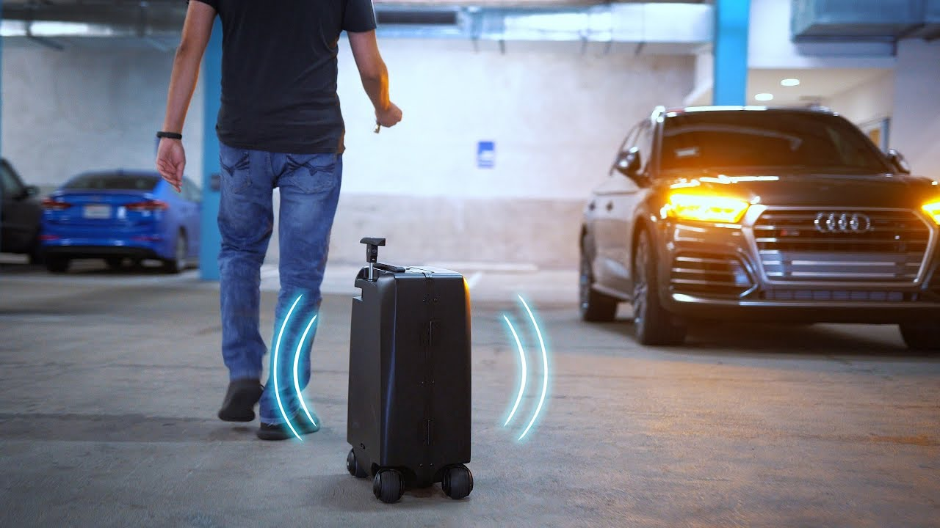


Target Audience & Market Analysis
JOCO's unique selling points and market positioning. It is a Competitive landscape in the smart luggage market. focus on delivering a superior travel experience
The unique features and benefits of JOCO position it as a leading choice for travelers seeking a premium and reliable smart luggage solution
Business professionals, vacationers, Tech enthusiasts, and frequent flyers comprise a significant portion of JOCO's target audience
Executives, consultants, and remote workers find value in JOCO's hands-free operation and organizational features for managing work-related trips effectively

Slide 8

Upgrade Your Travel Experience with JOCO
Emphasize
Encouragement to invest in JOCO: Emphasize the transformative impact of JOCO on travel convenience and comfort, encouraging the audience to make the switch
Call
Call to action: Direct the audience to visit the website or retail stores to purchase JOCO today, providing clear instructions on how to access further information or make a purchase
Contact
Contact information for inquiries or assistance: Ensure that audience members have a means to reach out for additional support or clarification, reinforcing customer satisfaction and engagement

Slide 9


